Slide 1
Industrial Human Resource Geo-Visualization
Domain-Resource Management

Slide 2
Problem statement
In India, the industrial classification of the workforce is essential to understand the distribution of the labor force across various sectors. The classification of main workers and marginal workers, other than cultivators and agricultural laborers, by sex and by section, division, and class, has been traditionally used to understand the economic status and employment trends in the country. However, the current data on this classification is outdated and may not accurately reflect the current state of the workforce. The aim of this study is to update the information on the industrial classification of the main and marginal workers, other than cultivators and agricultural laborers, by sex and by section, division, and class, to provide relevant and accurate data for policy making and employment planning.

Slide 3
Technologies
EDA - Exploratory Data Analysis or (EDA) is understanding the data sets by summarizing their main characteristics often plotting them visually. This step is very important especially when we arrive at modeling the data in order to apply Machine learning.
Visualization - The process of finding trends and correlations in our data by representing it pictorially is called Data Visualization. To perform data visualization in python, we can use various python data visualization modules such as Matplotlib, Seaborn, Plotly, etc.
NLP - Natural language processing (NLP) is a field that focuses on making natural human language usable by computer programs. NLTK, or Natural Language Toolkit, is a Python package that you can use for NLP.

Slide 4
Approach
1) Merge all the csv data file provided to you and create data frame
2) The classical machine learning tasks like Data Exploration, Data Cleaning, Feature Engineering, Model Building and Model Testing. Use Natural Language Processing for analyzing the various core industries and group the business categories like Retail, Poultry, Agriculture, Manufacturing e

Slide 5
Source Code
import pandas as pd
from glob import glob
import matplotlib.pyplot as plt
import seaborn as sns
# Create a list of the file paths to the CSV files
file_paths = ['/content/DDW_B18_1500_NIC_FINAL_STATE_MIZORAM-2011.csv','/content/DDW_B18_1900_NIC_FINAL_STATE_WEST_BENGAL-2011.csv','/content/DDW_B18sc_0700_NIC_FINAL_STATE_NCT_OF_DELHI-2011.csv','/content/DDW_B18sc_1600_NIC_FINAL_STATE_TRIPURA-2011.csv','/content/DDW_B18sc_2000_NIC_FINAL_STATE_JHARKHAND-2011.csv','/content/DDW_B18sc_2400_NIC_FINAL_STATE_GUJARAT-2011.csv','/content/DDW_B18sc_2700_NIC_FINAL_STATE_MAHARASHTRA-2011.csv','/content/DDW_B18sc_2900_NIC_FINAL_STATE_KARNATAKA-2011.csv','/content/DDW_B18sc_3000_NIC_FINAL_STATE_GOA-2011.csv','/content/DDW_B18sc_3200_NIC_FINAL_STATE_KERALA-2011.csv','/content/DDW_B18sc_3300_NIC_FINAL_STATE_TAMIL_NADU-2011.csv','/content/DDW_B18sc_3400_NIC_FINAL_STATE_PUDUCHERRY-2011.csv','/content/DDW_B18st_0200_NIC_FINAL_STATE_HIMACHAL_PRADESH-2011.csv','/content/DDW_B18st_0500_NIC_FINAL_STATE_UTTARAKHAND-2011.csv','/content/DDW_B18st_0900_NIC_FINAL_STATE_UTTAR_PRADESH-2011.csv','/content/DDW_B18st_1000_NIC_FINAL_STATE_BIHAR-2011.csv','/content/DDW_B18st_1100_NIC_FINAL_STATE_SIKKIM-2011.csv','/content/DDW_B18st_1300_NIC_FINAL_STATE_NAGALAND-2011.csv','/content/DDW_B18st_1800_NIC_FINAL_STATE_ASSAM-2011.csv','/content/DDW_B18st_2100_NIC_FINAL_STATE_ODISHA-2011.csv']
# Merge the CSV files
df = pd.concat([pd.read_csv(path, encoding='latin-1') for path in file_paths])
# Save the dataframe
df.to_csv('merged_file.csv')

Slide 6
df.head(5)
df.isna().sum()
df.duplicated()
df.shape
df.info()
df.drop(['State Code'], axis=1, inplace=True)
df.drop(['District Code'], axis=1, inplace=True)
df.drop(['Group'], axis=1, inplace=True)
dforiginal=df.copy()
df.drop_duplicates(subset=['NIC Name'], inplace=True)
df['NIC Name'].shape
df['NIC Name_data'] = df['NIC Name'].str.replace("[^a-zA-Z0-9]", " ")
df = df[['NIC Name_data']]
df['NIC Name_data']
df['NIC Name_data'] = df['NIC Name_data'].fillna("")
df['NIC Name_data'] = df['NIC Name_data'].apply(lambda x: ' '.join([w for w in x.split() if len(w)>2]))
df['NIC Name_data']
df['NIC Name_data'] = [rev.lower() for rev in df['NIC Name_data']]

Slide 7
df['NIC Name_data']
pip install nltk
import nltk
nltk.download('punkt')
nltk.download('stopwords')
from nltk.corpus import stopwords
from nltk import word_tokenize
stop_words = stopwords.words('english')
def remove_stopwords(des):
description_tokenized = word_tokenize(des)
des_new = " ".join([i for i in description_tokenized if i not in stop_words])
return des_new
df['NIC Name_data'] = [remove_stopwords(r) for r in df['NIC Name_data']]
df['NIC Name_data']

Slide 8
nltk.download('wordnet')
from nltk.stem import WordNetLemmatizer
from nltk.corpus import wordnet
nltk.download('averaged_perceptron_tagger')
lemmatizer = WordNetLemmatizer()
def nltk_tag_to_wordnet_tag(nltk_tag):
if nltk_tag.startswith('J'):
return wordnet.ADJ
elif nltk_tag.startswith('V'):
return wordnet.VERB
elif nltk_tag.startswith('N'):
return wordnet.NOUN
elif nltk_tag.startswith('R'):
return wordnet.ADV
else:
return None

Slide 9
def lemmatize_sentence(sentence):
nltk_tagged = nltk.pos_tag(nltk.word_tokenize(sentence))
wordnet_tagged = map(lambda x: (x[0], nltk_tag_to_wordnet_tag(x[1])), nltk_tagged)
lemmatized_sentence = []
for word, tag in wordnet_tagged:
if tag is None:
lemmatized_sentence.append(word)
else:
lemmatized_sentence.append(lemmatizer.lemmatize(word,tag))
return " ".join(lemmatized_sentence)
df['NIC Name_data'] = df['NIC Name_data'].apply(lambda x: lemmatize_sentence(x))

Slide 10
import matplotlib.pyplot as plt
import seaborn as sns
sns.set(style = 'white')
from nltk import FreqDist
all_words = ' '.join([text for text in df['NIC Name_data']])
all_words = all_words.split()
words_df = FreqDist(all_words)
words_df = pd.DataFrame({'word':list(words_df.keys()), 'count':list(words_df.values())})
words_df
words_df = words_df.nlargest(columns="count", n = 20)
words_df.sort_values('count', inplace = True)
plt.figure(figsize=(20,5))
ax = plt.barh(words_df['word'], width = words_df['count'])
plt.show()

Slide 11
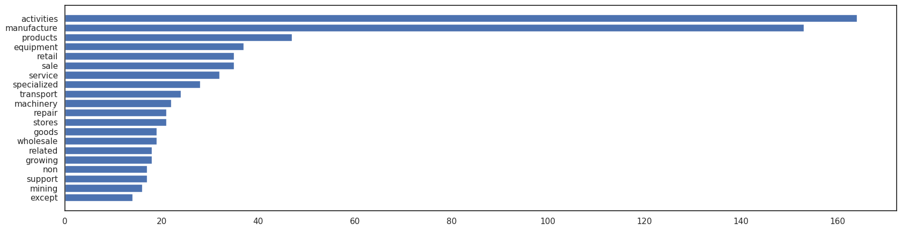
EDA- Exploratory Data Analysis

Slide 12
from sklearn.feature_extraction.text import TfidfVectorizer
tfidf = TfidfVectorizer()
feature = tfidf.fit_transform(df['NIC Name_data']).toarray()
featureNames = tfidf.get_feature_names_out()
Feature
from sklearn.cluster import Kmeans
from sklearn.preprocessing import StandardScaler
contat = []
list_k = list(range(1, 10)) for k in list_k:
km = KMeans(n_clusters=5)
km.fit(feature)
contat.append(km.inertia_)
plt.figure(figsize=(6,6))
plt.plot(list_k, contat, '-o')
plt.xlabel(r'Number of clusters')
plt.ylabel('inertia'); plt.show()

Slide 13
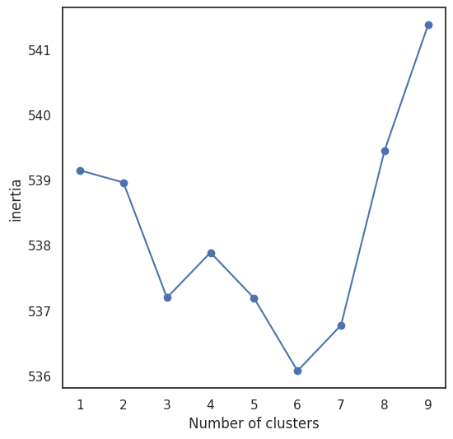
Visualisation

Slide 14
Result
Hence ,I have updated the information on the industrial classification of the main and marginal workers, other than cultivators and agricultural laborers, by sex and by section, division, and class, to provide relevant and accurate data for policy making and employment planning.

Slide 15
Thank You

